Slide 1
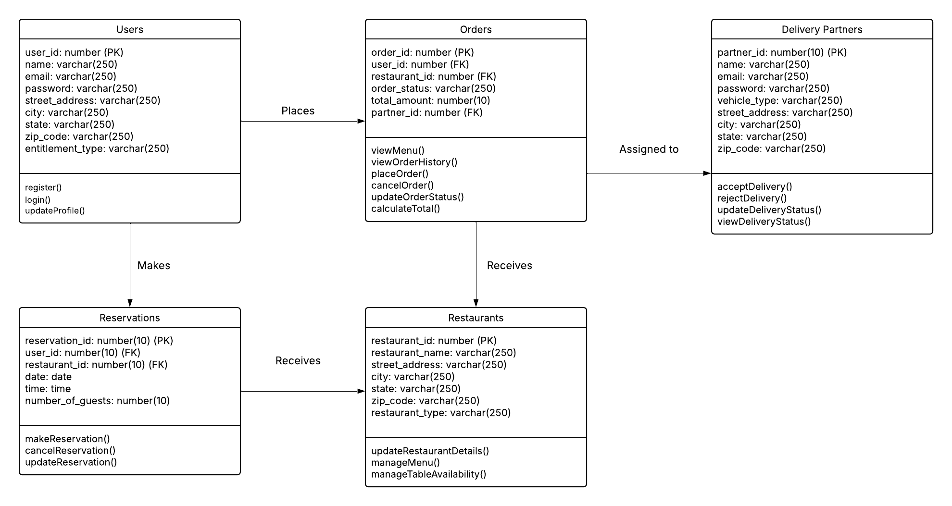
Class Diagram : DineDash

